Slide 1
Disaster management and planning

Slide 2
CONTENT
Nature, scope, and Management Process
Policy of Disaster Management
Types of Plans: Management by Objectives
SWOT analysis
Hazard and Vulnerability Analysis
Identifying Crisis situation
Organizational Structure and Design

Slide 3
CONTENT
Authority, Delegation and Decentralization
Role, skill, and, Competencies
Importance of Control Process in Disaster Management
Group Dynamics : Nature, Approach, and Attitudes Required to Establish Effective Autonomous Work Groups
Understanding the Importance of Team-Building in Disaster Management
Capability Assessment

Slide 4
Nature, scope, and Management Process
Management is about accomplishing goals by optimum and judicious utilization of resources.
Management is indispensable to any of disaster, irrespective of the size or nature of events.
Ascertaining responsibility for the utilization of both humans and materials is required.
With proper management practices, we can avert a major disaster and losses can be controlled.
So disaster management should focus on the optimal utilization of available resources for reducing or limiting the impact of disaster.

Slide 5
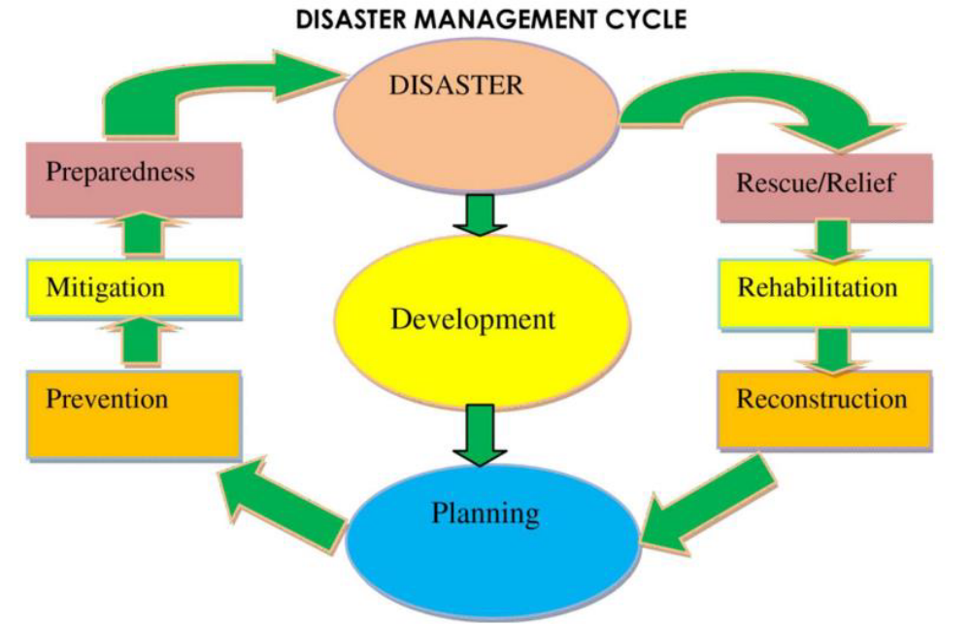
Disaster Management Process

Slide 6
Policy of Disaster Management
Policy is a principle of action adopted to guide decisions and achieve outcomes.
Policies are considered to help in guiding action to achievement of goals to avoid some negative effects and seek some positive benefits.
The disaster management policy aims at the following points.
To provide guidance and direction to set priorities for managing the disaster situation
To promote community-based disaster management and execution at the grassroots level.
To develop the capacity of all stakeholders
To facilitate cooperation with agencies at national, regional, and international levels
To integrate disaster management issues into the development planning process
To visualize reconstruction and opportunity to build disaster–resilient structures.
To take time-bound actions for response, relief, rehabilitation, and reconstruction.

Slide 7
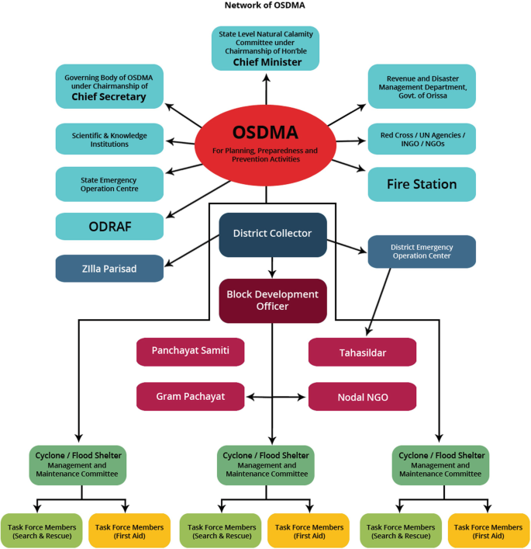
Hierarchy of disaster management from grass root level and stakeholders involvement

Slide 8

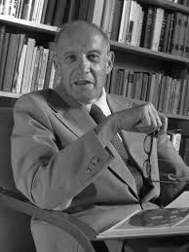
Types of Plans: Management by Objectives (MBO)
In disaster management, planning plays a crucial role. It deals with chalking out a future course of action and deciding the most fitting course of action for achievements. But sometimes, it is seen that even the best laid plans fail for lack of clarity.
The Management of Objective (MBO) was first presented by Peter Drucker in his book “The Practice of Management” in 1954.

Slide 9
MBO
Clarity of Goals: The Individuals working for the management of disasters have a clear goal in their mind, to which they are accountable. They are committed and motivation is very important to set goals.
Effective synergy between overall objectives and individuals’ objectives: Disaster management is everyone’s business. All are involved in one way or the other, and individual has a role to play in mitigating and preparing for disasters. It is a group commitment to reach the goal of effective management.
Timeliness : MBO ensures that objectives are achieved within a given time frame, known as the ‘operational period’. It is helpful as it ensures committed action from stakeholders.

Slide 10
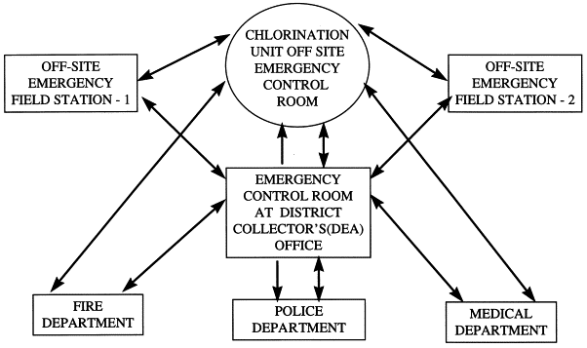
Set off co-ordination with emergency services.

Slide 11
Strengths, Weaknesses, Opportunities, and Threats (SWOT) analysis
It is a method used to evaluate the strengths, weaknesses, opportunities, and threats concerned with disasters. SWOT analysis can be carried out from micro to macro level. The three levels at which it should be done are as follows :
Community level: Information related to economic status, social status, age group, gender division, Nature of houses, vulnerability of the community to risk, etc should be gathered for SWOT.
Regional level : Information needed on overall capacity of the people living in the region to cope with and combat disaster, the nature of infrastructure, population density and nature of occupation.
National level: At national level, the information on a SWOT analysis should take into account are , political vulnerability, economic status and regional proneness to risk.
This analysis is helpful in giving a clear picture of what is and what needs to be done for effective management of disaster.
SWOT analysis for different disasters is different.

Slide 12
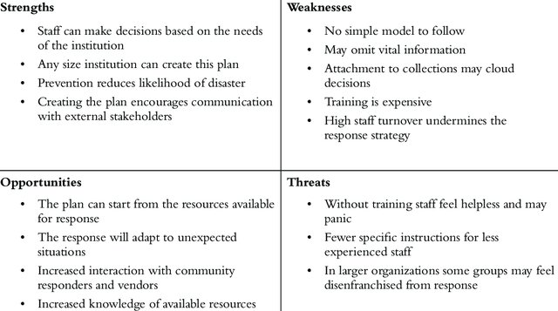
Common SWOT analysis

Slide 13
Hazard and Vulnerability Analysis
It is defined as a process of defining and describing a hazard, including its physical characteristics, magnitude and severity, probability and frequency, causative factors, and locations/ areas affected.
Vulnerability analysis involves understanding the root causes or drivers of vulnerability, but also peoples capacities cope and recover from disasters. It can be studied
Economic dimension :
Physical dimension
Social dimension
Environmental

Slide 14
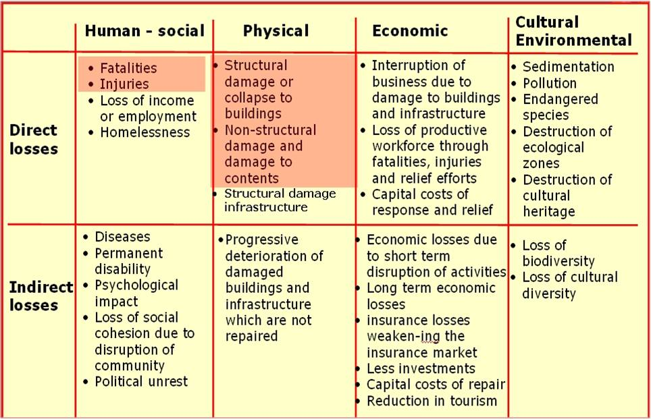
Hazard and Vulnerability Analysis

Slide 15
Hazard and Vulnerability Analysis
Vulnerability analysis is a risk, hazard, vulnerability and capacity mapping exercise that helps in recognizing the threats to communities. This analysis helps in addressing the specific areas of risk and vulnerability for making action plans.
The steps of a hazard and vulnerability analysis are as follows:
The vulnerabilities should cover diverse aspects, including social, infrastructural, economic, environmental, behavioural, and political hazards.
Estimation of the probability of occurrance of an event.
An analysis of the probable human impact of each disaster in terms of loss of lives and quantum of physical injury.
An assessment of the probable damage to the property.
An assessment of capacity, highlighting the capability and availability of resources with the community to reduce disaster risks and to organize effective response.

Slide 16
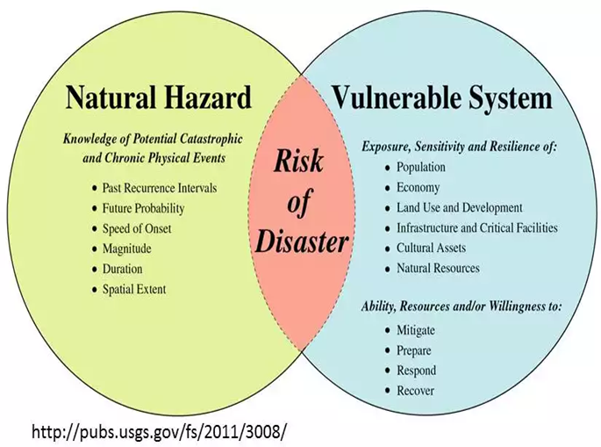
Hazard and Vulnerability Analysis

Slide 17
Identifying crisis situations:A framework
Crisis is an unwanted situation that takes people by surprise and pose a threat to the community. A crisis has the potential to cause harm if not handled timely or properly. Three phases of crisis management are as follows :
Pre-crisis phase: Where the focus is on the identification of the crisis. Its prevention and preparation for combating the situation.
Crisis response phase: When the community has to respond to the crisis
Post-crisis phase: Wherethe stakeholders review the situation and ascertain the reasons for the occurrence of the crisis.

Slide 18
Organization Structure and Design
Organisation Structure is a blueprint of formal division of the authorities and roles for ease
of decision-making.
The organizational structure for disaster management has four distinct departments based
on the functionalities:
Disaster mitigation division
Disaster preparedness division
Disaster response division
Disaster recovery division

Slide 19
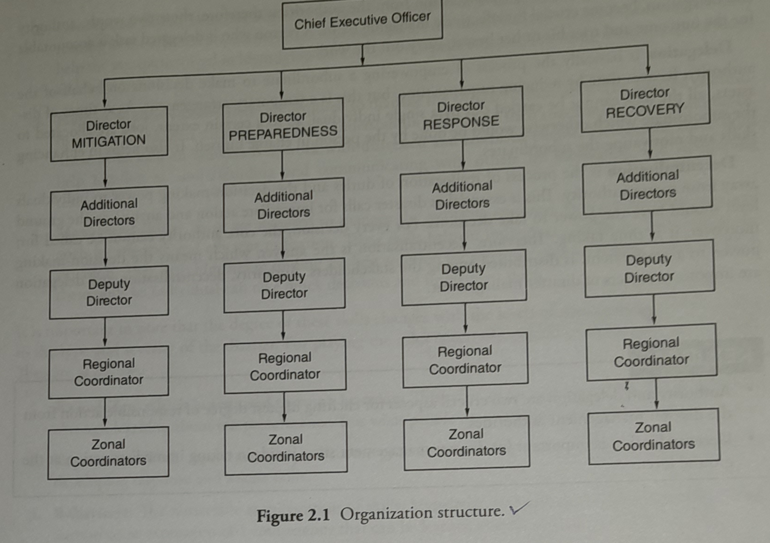

Organization Structure

Slide 20
Authority, Delegation and Decentralisation
The word 'authority' is used to mean power vested formally on an individual by a state.
Delegation is the transfer of authority and responsibility to a person or position to carry out definite activities.
These are the essence of management and very vital from a disaster management perspective.

Slide 21
Delegation
Delegation is basically the process of empowering a subordinate to make decisions on behalf of the authority. It saves time by reducing response time, but this is a temporary arrangement.
As at times of disasters, all the jobs cannot be carried out by a single individual, so to a certain extent, jobs are allocated to the subordinate, which otherwise would be done by the person in charge himself.
It also helps in enhancing skills and motivating the subordinates.

Slide 22
Decentralisation
Is the process of reallocation of duties and the decision-making power to an individual away from a core authority.
This is essential as disaster calls for immediate action and anyone on the ground level should have the power to take decisions.
For every decision, the core authority cannot be called for; moreover, it is time taking.
Therefore, decentralisation is the answer, which means the decision-making power to a great extent, is distributed among the stakeholders.

Slide 23
Roles, Skills and Competencies
For effective management of disasters, there are certain roles that individuals have to play;
these are as follows:
Leader: A leader's role entails taking the initiative to act and influence people to work for the achievement of goals. The leader organizes the requisite support from the agencies by collaborating with them and helps aid rescue and relief work. The duty of a leader is also to motivate people towards action, in both the pre-disaster and post-disaster phase
Informational Role: It deals with the collection and dissemination of accurate information relating to the exact situation of disasters in order to handle them carefully.
Resource Allocator : During disastrous events, a lot of resources in terms of materials pour in. It is important to make judicious allocation of the resources by ascertaining the needs of the affected population. This is an important role that has to be played well by the persons in charge.

Slide 24
For properly taking on these roles, certain skills are required. These are as follows:
Leadership skills
Conceptual skills
Human relations skills
Manegerial skills

Slide 25
Leadership skills
These are required to ensure availability of the right person at the right place and right time during chaotic situations like that of a disaster.
Conceptual skills:
These are required to gauge the reason of disaster and understand the intricacies relating to the affected population. Conceptual skills are the capabilities to visualise the situation. They help the person involved in identifying the causes of the problems and in solving them to reduce losses and damage.

Slide 26
Human relations skills:
These are required to manage the affected community. The affected community needs emotional support; therefore, understanding them and their needs is of prime importance.
These skills help an individual to work with distressed and confused people.
Developing these skillshelpsp him/her in understanding and communicating with others by motivating and developing team spirit.
Managerial skills:
These are required to manage the available resources to meet the objectives and goals by effective and efficient utilization. These skills help an individual coordinate and control the situation. They help him/her in finding the best solution for solving a disaster-related problem. With these skills, an individual can make quick decisions and implement them.

Slide 27
For playing the roles effectively certain competencies are required.
They are as follows:
Knowledge, which is acquired through learning
Experience
Behavior

Slide 28
Importance of Control Process in Disaster Management
The benefits of a control process are as follows:
Helps in achieving goals
Makes efficient use of resources by ensuring that each activity is performed
according to predetermined standards. As a result, there is most and effective
use of resources.
Improves employee motivation
Ensures order and discipline
Facilitates co-ordination in action
Help in minimizing errors

Slide 29
Types of Control
Feed forward control
A process by which the consequences of an action are pre-judged on the basis of the
Situation and control is triggered
Concurrent control
When working or responding to disaster, many a time it is found that the actions do not
Lead to expected response; in such cases, it is imminent that the action should be stopped
Immediately and the situation brough under control
Feedback control
An analysis of the action of the past gives insights and learning about what went wrong,
So that in future, such errors are not repeated

Slide 30
Group Dynamics: Nature, Approach and Attitudes Required to Establish Effective Autonomous Work Groups
Group dynamics is a classification of behaviors and processes taking place within and between social groups that helps in decision-making in a disaster situation

Slide 31
Understanding the Importance of Team-Building in Disaster Management
In teams, individuals collaborate in order to deliver the desired results. Teamworkm work helps foster better and open communication between individuals, thereby making it easy to operate in disastrous situations.
Team-building for disaster management helps in motivating individuals and build trust among them
A team has shared values and a common goal
The team has a unique identity where individuals are equally and fairly treated.
Teamwork as a whole is rewarded and promoted.
Strong teams and not strong individuals are what make up a strong association
A team shares values, integrity and commitment
An effective team takes risks

Slide 32
Capability Assessment
For effectively managing disasters, an assessment of capability is required. Capability assessment helps in getting a realistic view of the quality and quantity of available resources for mitigating disasters and responding to disasters.
It can be done by ascertaining the availability of resources to respond to a disaster in terms of
Personnel: It means the number of persons who are ready to come forward to help at times of disasters and the skills and experience they possess
Equipment and materials:
This involves assessing the current availability of equipment and relief materials, such as vehicles, storm shelters, alarm systems, communications equipment, security, emergency power system and fuel, sanitation, medical or first-aid, cots and blankets, etc

Slide 33
Key Idea
Capability assessment is an important part of emergency management plans.
It can be done by ascertaining the availability of resources to respond to a disaster in terms of personnel and equipment.

